Slide 1
Behavior Driven Development
From The Trenches

Slide 2

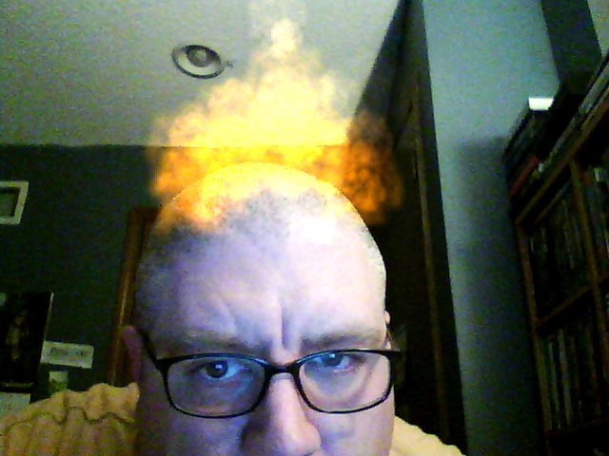



Lee Brandt
Project Lead Consultant
13 Yrs Programming
Early .NET Betas
TDD / BDD Enthusiast
http://disruptivetheory.com
leebrandt@gmail.com
@leebrandt

Slide 3
DISCLAIMERS
My opinions are mine, no one else’s.
If you don’t like what you hear, blame me.
My opinions are my opinions as of TODAY.
And are based on what I know TODAY.
I ALWAYS love to learn how others are doing things.
Continuous learning… ‘nuff said.

Slide 4
Don’t we already have TEST Driven Development?

Slide 5

Notes:
In the beginning… there were Unit Tests
Done afterward
First thing to get cut when budget/deadline imposed
Then I started doing TDD
I wrote my tests BEFORE I wrote the code
Hadn’t done enough Unit Testing to be overly tainted (should thank those budget/deadline constraints)
Saw vast improvements in the modularity of my code
Thought I was getting the max benefit from TDD
WRONG!

Slide 6
The Intention
Notes:
People (including myself) took those unit tests that they wrote after they wrote the code,
And wrote those same tests before writing each code unit.
People (me too) got confused about how to test a unit that doesn’t exist.
Where to begin?

Slide 7
What actually happened.

Slide 8
Test Fixture
Class
Notes:
Using TDD, a lot of people ended up using the anti-pattern of a fixture per class and 1-n Tests per method
Structure of the test code matches the structure of your production code.

Slide 9

TDD Comes Up Short
not the intent
the language misleads
not about testing

Slide 10

BDD
Notes:
Dan North – Coined the term
Thinking about why it is so hard to teach TDD

Slide 11
BDD is NOT something new
Notes:
Help Drive DEVELOPMENT
Write a TEST that expresses what you want the code to DO
THEN write code to make your application do that
HAPPY COINCIDENCE: The original test is left behind to ensure that your application always can do everything it should do

Slide 12
BDD is a shift in TDD language that helps guide you to do TDD the way it was meant to be done.

Slide 13

3 for $12

Slide 14
Ubiquitous Language
(User Voice)
Notes:
Story about Trading Credit Derivatives
Perturb an interest rate curve and calculate the value of a Collateral Debt Obligation (CDO)

Slide 15
BDD
DDD
TDD
Notes:
DDD and BDD are MASSIVELY complimentary
DDD gives you the vocabulary
BDD are sentences that you make with those words

Slide 16
Two Types of BDD
Story-Based (Concentric Circle)
Outside Circle => JBehave, SpecFlow, Cucumber
Inside Circle => NSpec, MSpec, Rspec
Context-Specification
Outside => Interactions (Lots of Mocks)
Inside => Specs for each Outside Mock

Slide 17
Demo
Shut Up Already, And Get To The

Slide 18
Questions and Techniques
Implicit Requirements
Garage Example
Foundation
Electrician
Building Permit
Inspection
Outside-In Development
Start with the outermost layer (layer closest to the stakeholder/consumer)
Work your way down the layers
Stay in User Voice

Slide 19
Scrum, Kanban & XP OH MY!
User Stories
Role – Goal – Motivation
As a [Role] I need to [Goal] so that [Motivation]
As an Account Holder I need to be able to transfer funds from my savings to my checking so that I don’t bounce checks.
Scenarios
Context – Action – Observation
Given [Context] When [Action] Then [Observation]
LANGUAGE
All about expressing the user’s needs and
what it means to the user to have those needs filled.

Slide 20
Given I have an inventory of Parts
When loading the part search page
Then I should see an empty search form

Slide 21
User Interface
Web Interface
Windows Interface
User Interface Layer
Presentation Layer
Domain Objects
Services
Persistence
Notes:
User interface testing should still be done external to BDD
BDD is done to DRIVE DEVELOPMENT and leaves a trail of UNIT tests behind as a happy coincidence

Slide 22
.Net Frameworks
SpecUnit.Net
Scott Bellware
MSpec
Part of MultiFunctionMachineMachine
Aaron Jensen & Jacob Lewallen
SpecFlow
Gherkin
Specflow.org
Nbehave
Jbehave
Joe Ocampo & Jimmy Bogard
Nbehave.org
Notes:
Some frameworks that can help you get focused on BDD and away from the test-centric language of unit-testing frameworks

Slide 23
People
Dan North | Liz Keogh
Dave Astels | Scott Bellware
Aaron Jensen | Jacob Lewallen
Jimmy Bogard | Joe Ocampo
Derrick Bailey | Tim Haughton
Notes:
Some of the people to look for when looking for good BDD information

Slide 24
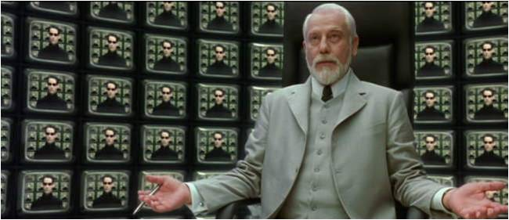

Slide 25
WWW.DISRUPTIVETHEORY.COM
Thank You
Papers
http://behaviour-driven.org
http://dannorth.net/introducing-bdd/
Videos
http://domaindrivendesign.org/events/oopsla2007/dan_north/
http://video.google.com/videoplay?docid=8135690990081075324
http://blog.wekeroad.com/mvc-storefront/kona-3/
Blogs
http://techblog.daveastels.com/
http://lizkeogh.com/
http://dannorth.net/
Lee Brandt
Email: leebrandt@gmail.com
Twitter: @leebrandt

